Slide 1

Olive Kajubu

Slide 2
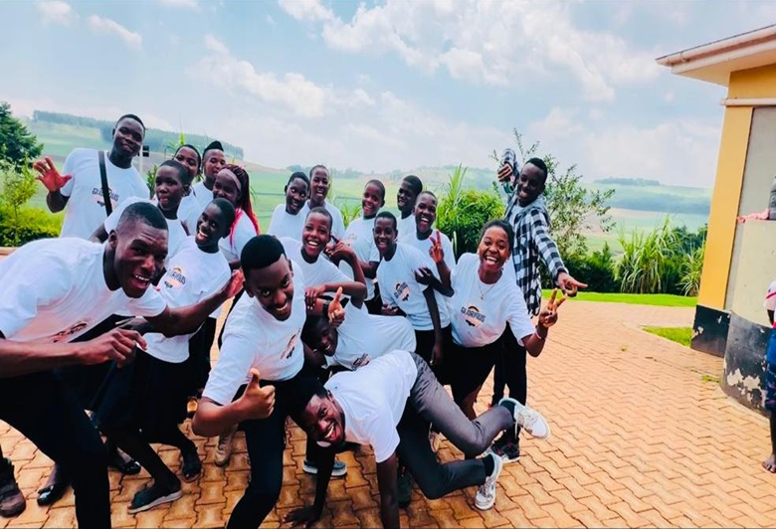
WORSHIP HARVEST KITO-KISOOBA
Worship Harvest Kito-Kisooba started on the 19th of February, 2023 at the Nile River Skilling Institute in Lugazi town.
Our vision is to transform the community through discipleship of the people in the knowledge of Jesus.
We are a movement of the gospel, discipleship and mission.
We exist for the purpose of catalysing spiritual, social and economic renewal in our immediate communities and as a result, the world!

Slide 3
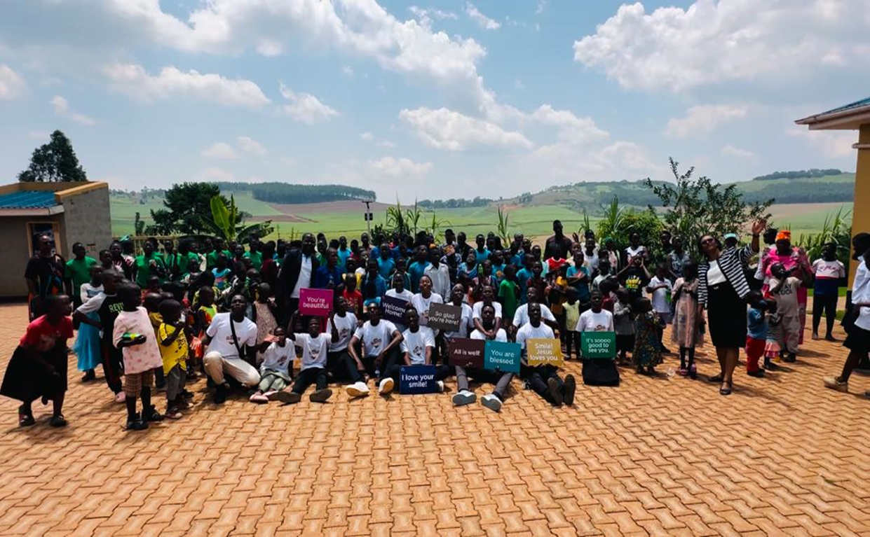
The Journey
Worship Harvest Kito-Kisooba has grown over the past two years by the grace of God.
The Church has moved from one service to two services on Sundays - The English service for the youth and the local language service for the people in the community, to give everyone the opportunity to hear and receive the gospel.
We have grown from about 40 people at the start to now 300 people.
Our Church family has smaller groups called Missional Communities, where discipleship happens, away from the larger crowd. We do life together by meeting up in different homes every week to encourage each other. The missional communities have grown to 22 in number and shall continue to grow.

Slide 4
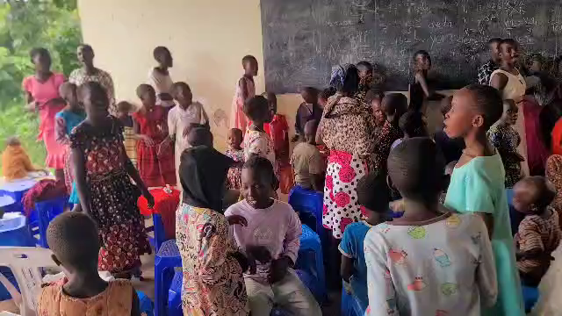

Slide 5
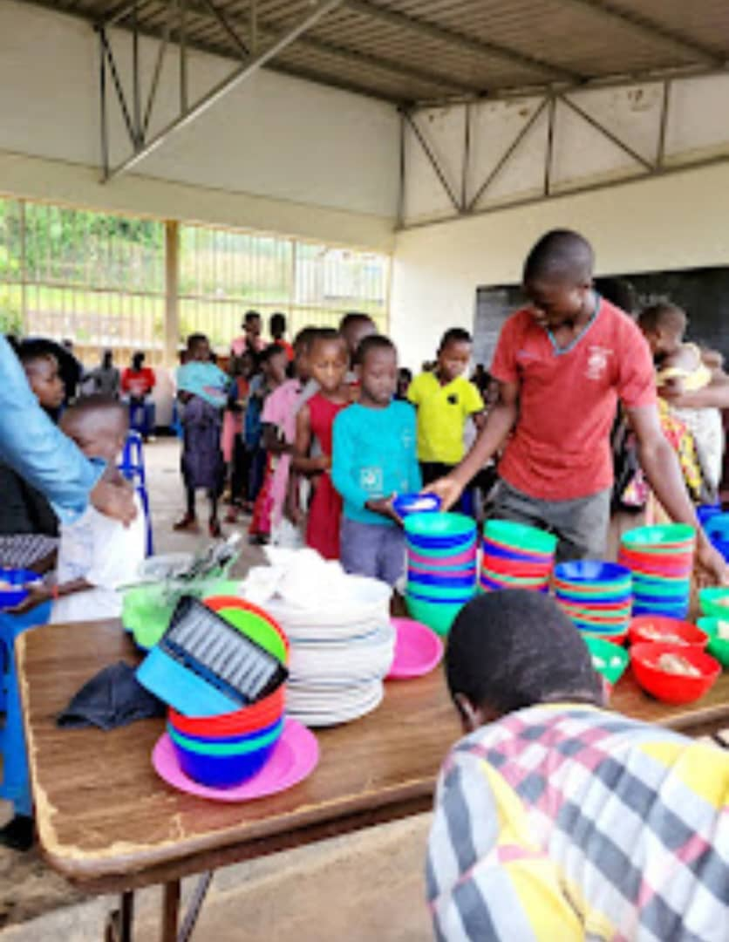
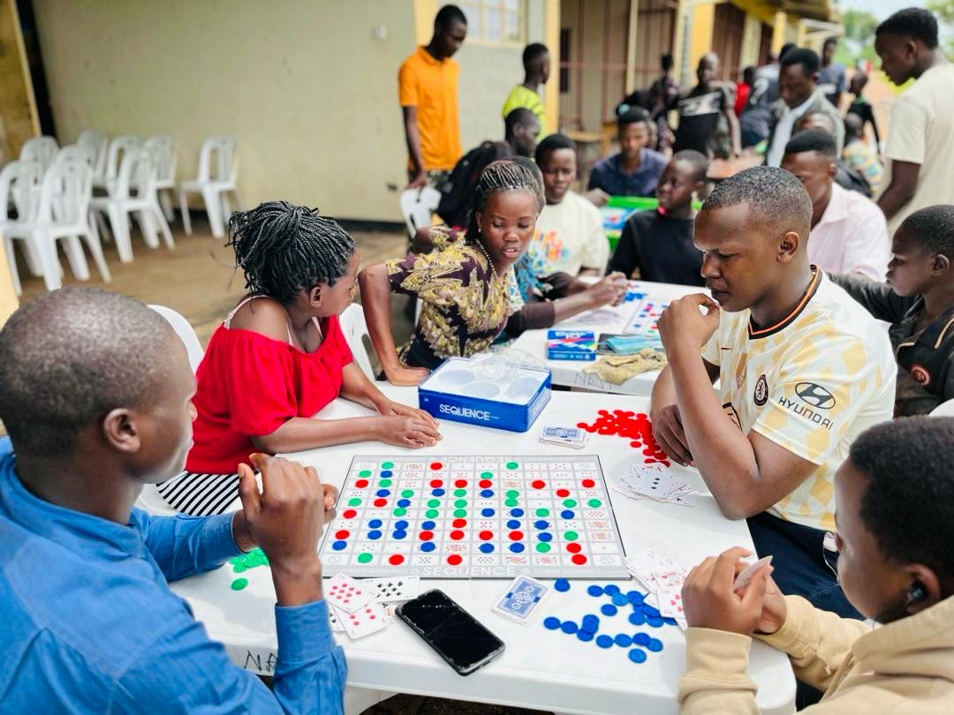
Events
We have events that have greatly impacted the people in the community. Community outreaches, crusades and many other events have been held by the church, with the biggest goal of bringing many souls to Christ.

Slide 6
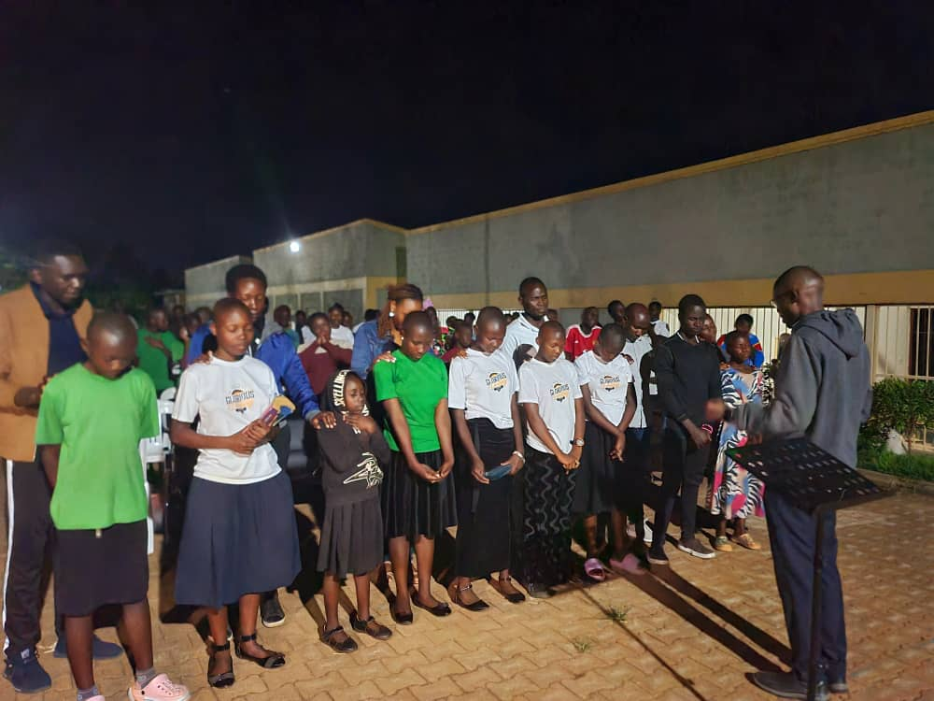
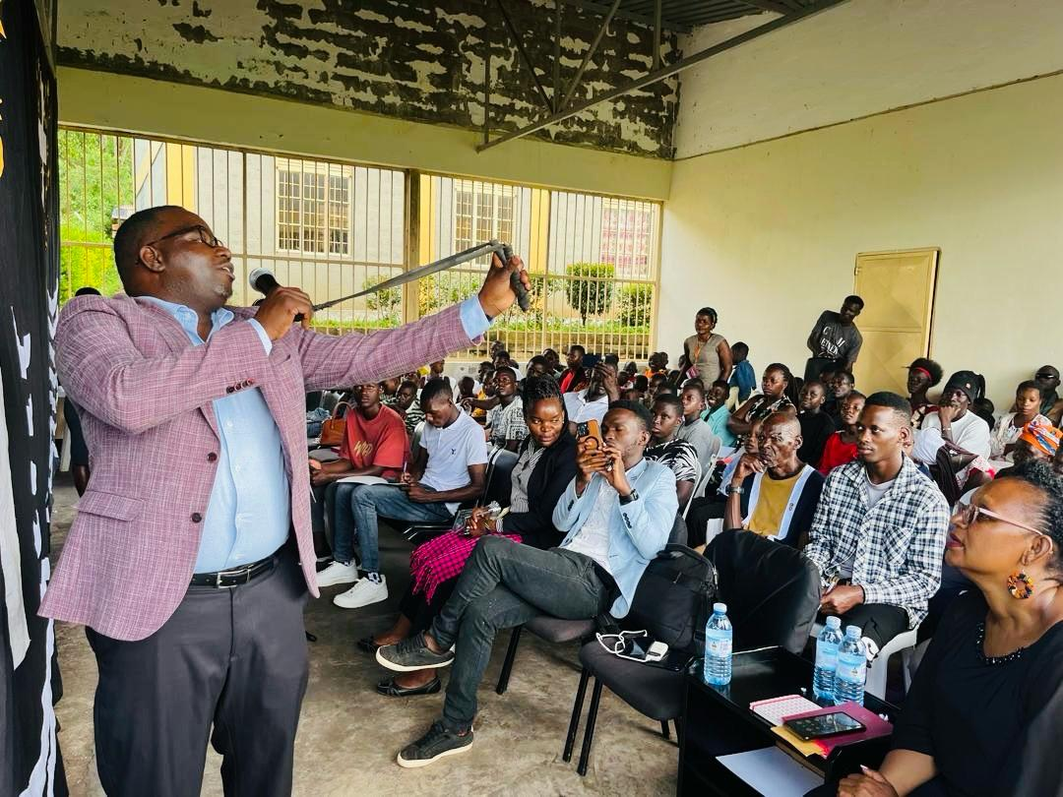
We’ve had a number of guest preachers that have visited and ministered to us.

Slide 7
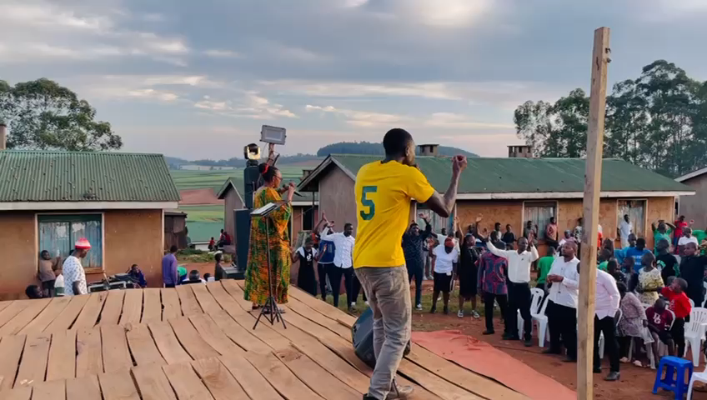

Slide 8
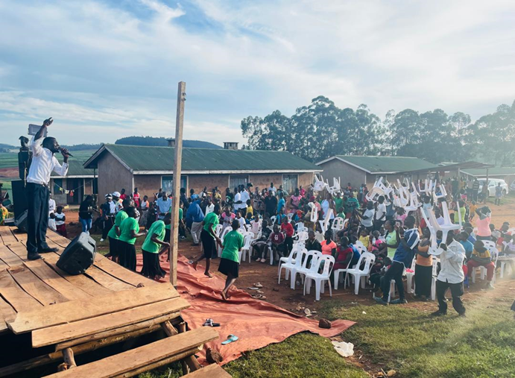
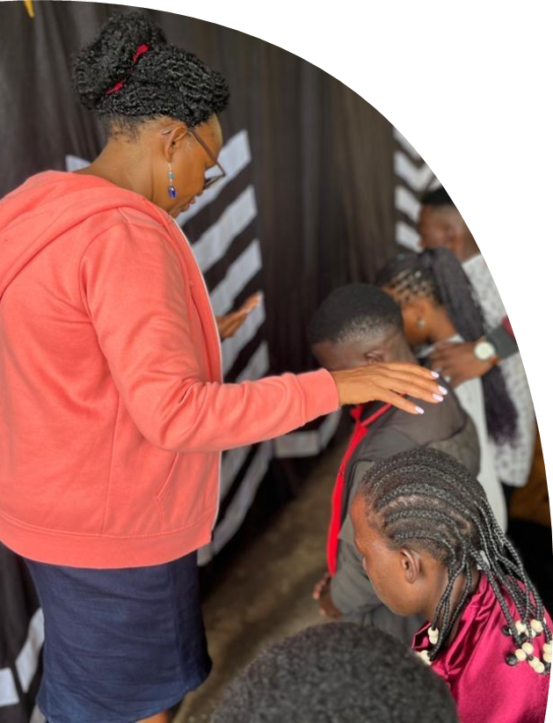

Slide 9
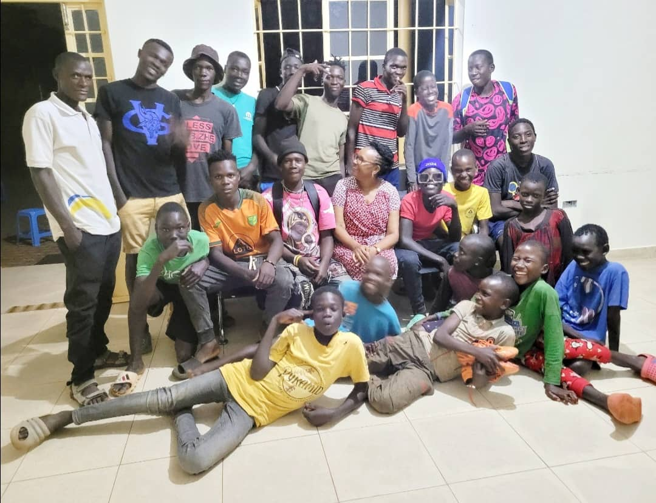
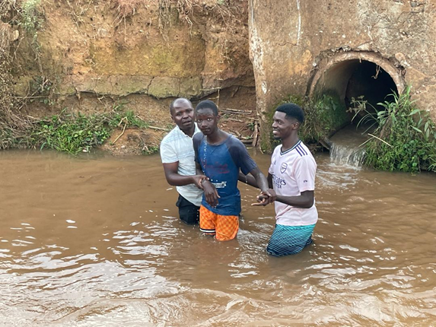
Since it’s beginning, the church has helped lead 583 people to Christ, baptized 174 and have 396 people being discipled to do the same.

Slide 10
We are more than thankful to God for His goodness and faithfulness in our story. We know that Worship Harvest Kito-Kisooba is a beacon of hope, love and a reflection of God’s glory. This is only the beginning.
We want to thank Community Bible Church for now supporting the church.

